Slide 1
Halving

Slide 2
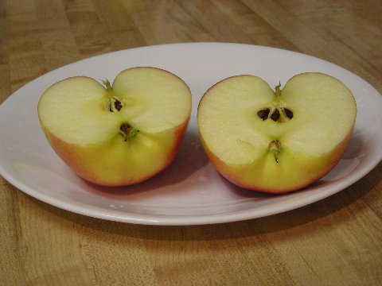
When we halve something we cut it or divide it into two equal parts

Slide 3
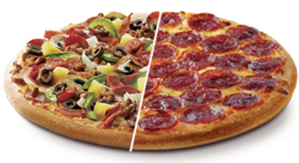

Slide 4
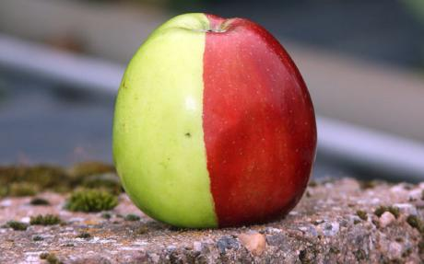

Slide 5
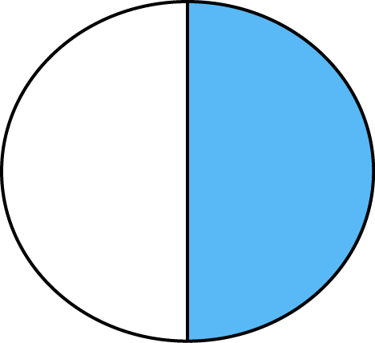
1 of the 2 halves is blue. So we can write……..
1
2 Of the circle is blue.

Slide 6
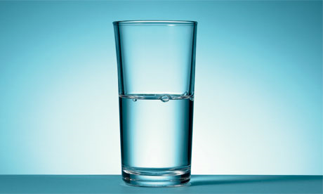
This glass is …..
1 full and
2
1 empty!
2
Two halves make a whole glass!
2
2

Slide 7
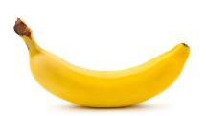

We can find half of numbers……
If I eat half of these bananas how many will I have left?
Half of 6 is 3

Slide 8
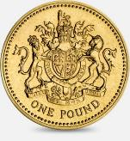

Tom has this much money. If he gives Ethan
half how much money does Ethan have?
Use cubes to work out the answer!
Half of £8 is £4

Slide 9
I want to colour in half of this pattern.
How many rectangles do I need to colour in?
Half of 10 is 5

Slide 10
Now use cubes to complete the halving sheets!

