Slide 1

Multiplication

Slide 2
multiply
times
X
lots of

Slide 3
Here are some arrays to show what multiply means.
3 x 2 = 6
3 lots of 2 are 6
5 x 2 = 10
5 lots of 2 are 10

Slide 4

When we multiply, we are
really adding together lots of
the same number.
+ 2 + 2 + 2 = 8
Four lots of 2 are 8
4 x 2 = 8

Slide 5

1 lot of 2 is 2 1 x 2 = 2
2 lots of 2 are 4 2 x 2 = 4
3 lots of 2 are 6 3 x 2 = 6
4 lots of 2 are 8 4 x 2 = 8
5 lots of 2 are 10 5 x 2 = 10
6 lots of 2 are 12 6 x 2 = 12
7 lots of 2 are 14 7 x 2 = 14
8 lots of 2 are 16 8 x 2 = 16
9 lots of 2 are 18 9 x 2 = 18
10 lots of 2 are 20
10 x 2 =20

Slide 6
So, let’s look at what the 2 times table means:
1 x 2 = 2 2 + 0 = 2 (1 lot of 2)
2 x 2 = 4 2 + 2 = 4 (2 lots of 2)
3 x 2 = 6 2 + 2 + 2 = 6 (3 lots of 2)
4 x 2 = 8 2 + 2 + 2 + 2 = 8 (4 lots of 2) and so on.
5 x 2 = 10 2 + 2 + 2 + 2 + 2 = 10
6 x 2 = 12 2 + 2 + 2 + 2 + 2 + 2 = 12
7 x 2 = 14 2 + 2 + 2 + 2 + 2 + 2 + 2 = 14
8 x 2 = 16 2 + 2 + 2 + 2 + 2 + 2 + 2 + 2 = 16
9 x 2 = 18 2 + 2 + 2 + 2 + 2 + 2 + 2 + 2 + 2 = 18
10 x 2 = 20 2 + 2 + 2 + 2 + 2 + 2 + 2 + 2 + 2 + 2 =20
Now you can see why it is easier to
write a multiplication!

Slide 7
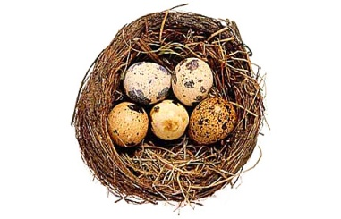
Let’s look at counting eggs in 5’s - the 5 times table.
How would we write these sums as times tables?
Write them on your whiteboards and remember we are counting the eggs!
2 x 5 = 10
4 x 5 = 20

Slide 8
- and that’s
MULTIPLICATION!

