Slide 1
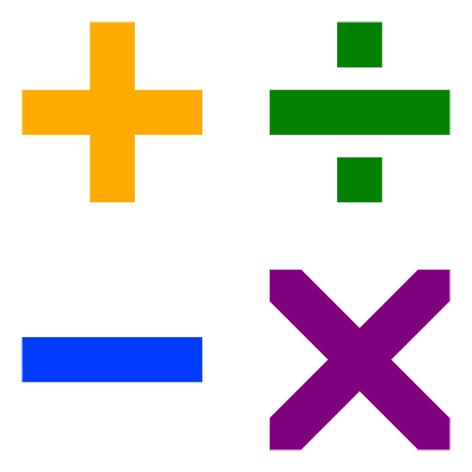
Mathematical Symbols

Slide 2
Mathematical Symbols
addition
increase; together; more; plus; sum; add; total; and; tally up.
subtraction
difference; between; subtract; decrease; reduce; fewer; minus; take from; deduct; take away.
multiplication
multiplied by; times; groups of; lots of; times table; multiply; product;
division
divided by; share; divide into; group; divisible by; divide; share; equally.

Slide 3
Addition
increase; together; more; plus; and; sum; add; total.

Slide 4
Subtraction
difference; between; subtract; decrease; reduce; fewer; minus; take from; deduct; take away.

Slide 5
Multiplication
multiplied by; multiply; times; groups of; lots of ; times table.

Slide 6
Division
divided by; share; divide into; divide; divisible by; group; share equally.

