Slide 1
Measurement –
Reasoning 1

Slide 2
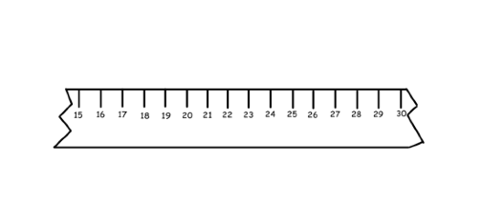
Unfortunately Imran has broken his ruler.
Trouble is he still has some Maths to do…
…and today’s topic is Measuring!
The question is, can he still use his ruler to
successfully complete his work.

Slide 3

Imran thinks that he can, but, instead of placing
whatever he is measuring at zero, he will have to
start at a different number.
8 cm
If Imran places his car on the number 20 on his ruler he can then count on to see how long his car is.

Slide 4
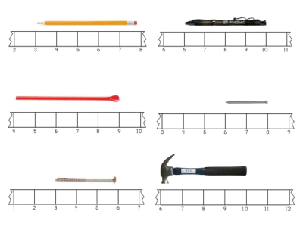
5 cm
4 cm
5 cm
2 cm
3 cm
4 cm

Slide 5
Problems
I have 3m of ribbon and I cut it into 50cm lengths. How many lengths can I cut? Convince me with your explanation.
Yesterday I drove 100 km in 4 hours. How many km did I drive each hour?
A coach is three times as long as a car. A train is 6.5m longer than the coach. The train is 36.5m long. How long is the car?

Slide 6

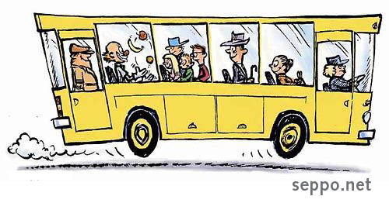
A coach is three times as long as a car. A train is 6.5m longer than the coach. The train is 36.5m long. How long is the car?
36.5m
36.5m
- 6.5m
= 30m
30m
3
= 10m

Slide 7
Joe is twice the height of Asher. Dilshan is 15cm taller than Joe. Dilshan is 175cm tall. How tall is Asher?
Amir gets four times as much pocket money as Sabrina. Josh gets 50p more than Amir. Josh gets £4.50 each week. How much does Sabrina get?
Steph has five times as many Pokemon cards as Harry. Lizzy has 25 more cards than Steph. Lizzy has 125 cards. How many cards does Harry have?
Can you make up a problem like this for your partner to solve?

