Slide 1
Measurement –
Reasoning 3

Slide 2
Length
1)Each red block is 8cm long.
A blue block is 6cm long.
How long is the yellow block?
2)Each blue block is 8cm long.
A yellow block is 6cm long.
How long is the red block?

Slide 3
1)Simon runs 4 times faster than Emma.
Kelly runs 3m further than Simon.
Kelly ran 47m.
How far did Emma run?
2)Fatima runs 3 times faster than Eshan.
Lucas runs 4m further than Fatima.
Lucas ran 85m.
How far did Eshan run?

Slide 4
Weight
1g
5g
10g
20g
50g
100g
Use these weights to make each scale balance:
130g
160g
190g

Slide 5
165g
185g
230g
245g
386g
397g

Slide 6
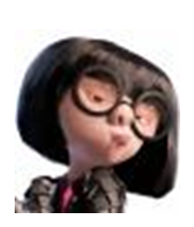
Capacity
Hello Agents,
You mission should you choose to accept it is to make a special liquid for Agent 99. He is currently tracking one of the world most dangerous criminals and needs a way to knock him out so they can put him in prison. They need 500ml made. The science department have worked out that there are 4 different types of chemical but you need to work out the different quantities of each one to make 500ml.

Slide 7
Here are some facts that the science department already know:
The amount of each chemical does not end in a 0 or a 5.
No two amounts can be the same.
The purple chemical needs to have the greatest quantity.
There needs to be more dark red chemical that dark blue.
There needs to be more yellow chemical than dark red.
Thanks for your help! I look forward to getting the results.
Agent G

Slide 8
Dear Agent G,
Please find our results below:
Chemical | Quantity (ml)
Purple
Dark Red
Dark Blue
Yellow
Total

