Slide 1
Multiplying and Dividing Fractions

Slide 2

Can you name the parts of a fraction?
$$\frac{3}{4}$$
?
numerator
?
denominator

Slide 3



What sort of fractions / numbers are these:
$$\frac{7}{8}$$
?
proper fraction
?
$$2\frac{3}{8}$$
mixed number
?
$$\frac{9}{7}$$
improper fraction

Slide 4


Multiplying Fractions
$\frac{2}{3}$×$\frac{3}{4}$=
Multiply the numerators.
Multiply the denominators.
Cancel down.
2 × 3 6
$$\frac{1}{2}$$
=
=
3 × 4 12

Slide 5




$\frac{2}{5}$ × $\frac{3}{4}$=
$\frac{1}{4}$ × $\frac{1}{2}$=
$\frac{3}{4}$ × $\frac{4}{5}$=
$\frac{4}{7}$ × $\frac{2}{5}$=
$\frac{1}{6}$ × $\frac{2}{5}$=
$\frac{5}{12}$ × $\frac{2}{5}$=
$\frac{5}{9}$ × $\frac{2}{3}$=
$\frac{3}{8}$ × $\frac{4}{9}$=
$\frac{6}{20}$=$\frac{3}{10}$
$$\frac{1}{8}$$
$\frac{12}{20}$=$\frac{3}{5}$
$$\frac{8}{35}$$
$\frac{2}{30}$=$\frac{1}{15}$
$\frac{10}{60}$=$\frac{1}{6}$
$$\frac{10}{27}$$
$\frac{12}{72}$=$\frac{1}{6}$

Slide 6




Multiplying mixed numbers.
2$\frac{2}{5}$ × $\frac{1}{2}$
Change the mixed number to an improper fraction.
Multiply as before.
Cancel down and change to mixed number if necessary.
$\frac{12}{5}$ × $\frac{1}{2}$
= $\frac{12}{10}$
= $\frac{6}{5}=1\frac{1}{5}$
=

Slide 7





1$\frac{1}{4}$ × $\frac{2}{7}$=
2$\frac{1}{3}$ × $\frac{1}{2}$=
$\frac{3}{4}$ × 1$\frac{4}{5}$=
1$\frac{4}{7}$ × 1$\frac{2}{5}$=
$\frac{5}{4}$ × $\frac{2}{7}$ = $\frac{10}{28}=\frac{5}{14}$
$\frac{7}{3}$ × $\frac{1}{2}$ = $\frac{7}{6}$ = 1$\frac{1}{6}$
$\frac{3}{4}$ × $\frac{9}{5}$ = $\frac{27}{20}$ = 1$\frac{7}{20}$
$\frac{11}{7}$ × $\frac{7}{5}$ = $\frac{77}{35}$ = $\frac{11}{5}$ =2$\frac{1}{5}$

Slide 8




Multiplying fractions and whole numbers
12 × $\frac{5}{6}$ =
$\frac{12}{1}$ × $\frac{5}{6}$
= $\frac{60}{6}$
$=$10
Whole numbers have a denominator of 1.
Multiply numerators and denominators.
Cancel down and change to a mixed number if necessary.

Slide 9


$$\frac{3}{4} ×\frac{6}{1}=\frac{18}{4}=4\frac{1}{2}$$
$\frac{7}{8} ×\frac{12}{1}=\frac{84}{8}=10\frac{1}{2}$
$\frac{5}{1} ×\frac{3}{10}=\frac{15}{10}=1\frac{1}{2}$
$\frac{5}{7} ×\frac{4}{1}=\frac{20}{7}=2\frac{6}{7}$
$\frac{7}{1} ×\frac{2}{5}=\frac{14}{5}=2\frac{4}{5}$
$\frac{3}{4}$ × 6 =
$\frac{7}{8}$ × 12 =
5 × $\frac{3}{10}$ =
$\frac{5}{7}$ × 4 =
7 × $\frac{2}{5}$ =

Slide 10


Cancelling down.
It is often easier to cancel down before you multiply.
When you are multiplying fractions, any numerator can be cancelled against any denominator.
After multiplication
$\frac{5}{8}$ × $\frac{16}{25}$ = $\frac{80}{200}$ = $\frac{2}{5}$
Before multiplication
$\frac{5}{8}$ × $\frac{16}{25}$ =
1
2
$$\frac{2}{5}$$
5
1

Slide 11



Cancelling after multiplication
$\frac{7}{12}$ × $\frac{16}{49}$ = $\frac{112}{588}$ = $\frac{4}{21}$
Cancelling before multiplication
1
4
$\frac{7}{12}$ × $\frac{16}{49}$ =
$$\frac{4}{21}$$
3
7
Which is easier?

Slide 12

Multiplying always makes things bigger:
2 x 3 = 6
6 is bigger than both 2 and 3
Is he correct?

Slide 13

If you multiply a number by 1,
it does not increase or decrease.
3 x 1 = 3
If you multiply a number by 0, you get 0
3 x 0 = 0
If you multiply a number larger than 1 by a proper fraction, the product is less than the original number.
4 x $\frac{1}{2}$ = 2 (2 < 4)

Slide 14
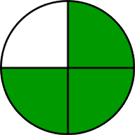
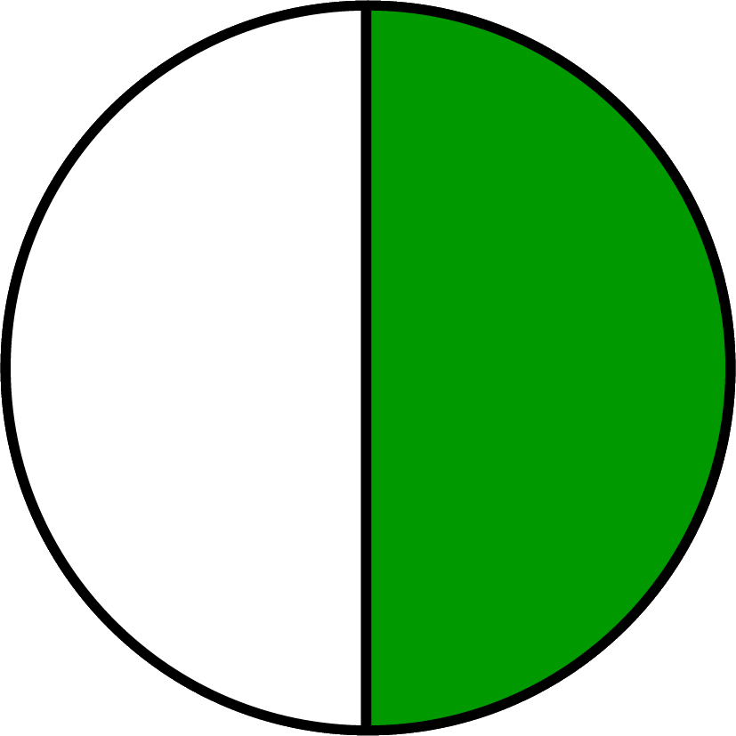
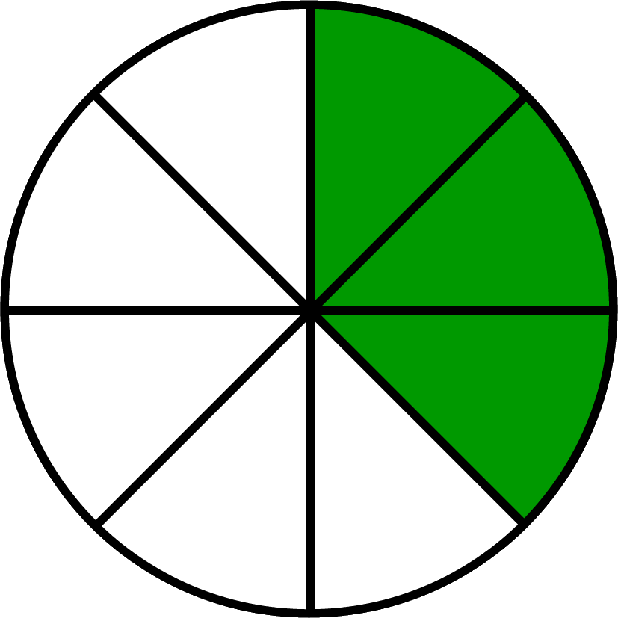
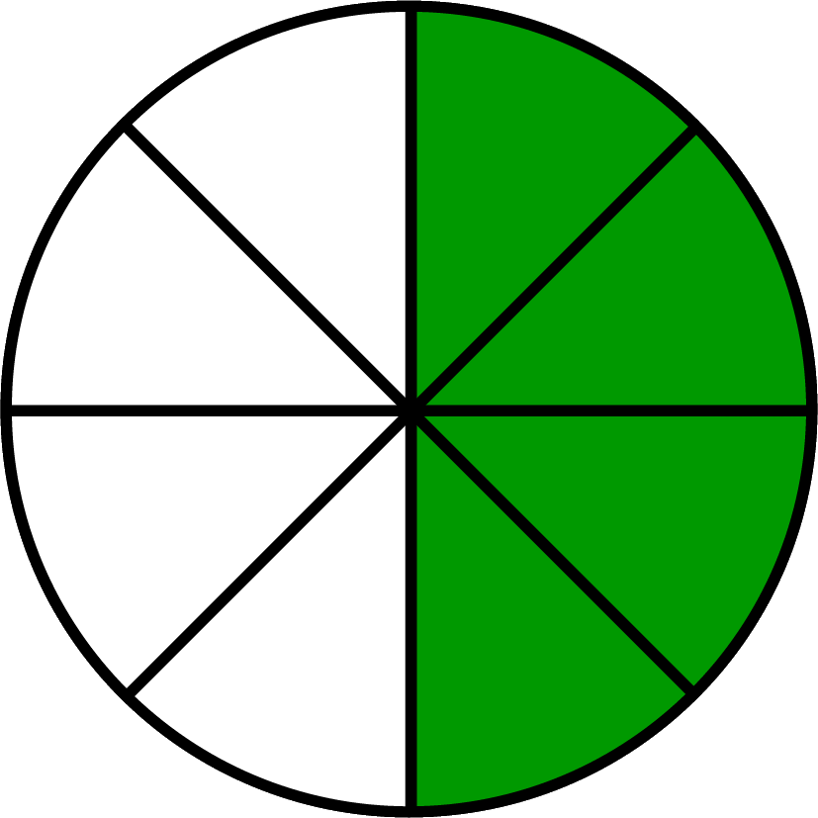



If you multiply two proper fractions together, the product is less than either of them:
$\frac{3}{4}$ × $\frac{1}{2}$ = $\frac{3}{8}$
of means ×
$\frac{1}{2}$ of $\frac{3}{4}$ = $\frac{3}{8}$
$\frac{3}{4}$ of $\frac{1}{2}$ = $\frac{3}{8}$
=
=

Slide 15






Dividing Fractions
$\frac{3}{4}$ ÷ $\frac{1}{3}$
$\frac{3}{4}$
$$\frac{3}{1}$$
=$2\frac{1}{4}$
=
÷
$$\frac{1}{3}$$
= $\frac{9}{4}$
×
Turn the dividing fraction upside down and change ÷ to ×.
Multiply numerators and denominators.
If necessary cancel down and change to a mixed number.

Slide 16





























$\frac{2}{5}$
$$\frac{4}{1}$$
= $\frac{8}{5}$
=$1\frac{3}{5}$
$\frac{2}{5}$ ÷ $\frac{1}{4}$
=
÷
$$\frac{1}{4}$$
×
$\frac{3}{7}$ ÷ $\frac{2}{5}$
$$\frac{3}{7}$$
$$\frac{5}{2}$$
= $\frac{15}{14}$
=
$$\frac{2}{5}$$
=$1\frac{1}{14}$
÷
×
$\frac{3}{4}$ ÷ $\frac{1}{8}$
$$\frac{3}{4}$$
$$\frac{8}{1}$$
= $\frac{24}{4}$
=
÷
$$\frac{1}{8}$$
=$6$
×
$$\frac{3}{1}$$
= $\frac{15}{6}$
=$2\frac{1}{2}$
$\frac{5}{6}$ ÷ $\frac{1}{3}$
=
$$\frac{5}{6}$$
÷
$$\frac{1}{3}$$
×
$$\frac{4}{9}$$
$$\frac{1}{2}$$
$\frac{4}{9}$ ÷ $\frac{1}{2}$
÷
$$\frac{2}{1}$$
= $\frac{8}{9}$
=
×

Slide 17




Dividing mixed numbers.
2$\frac{2}{5}$ ÷ $\frac{1}{2}$
Change the mixed number to an improper fraction.
Divide as before.
Cancel down and change to a mixed number if necessary.
$\frac{12}{5}$ ÷ $\frac{1}{2}$
= $\frac{12}{5}$ × $\frac{2}{1}$ =$\frac{24}{5}$
=$4\frac{4}{5}$
=

Slide 18










1$\frac{4}{5} ÷$ $\frac{1}{3}=$
$\frac{9}{5}$ ÷ $\frac{1}{3}$ = $\frac{9}{5}$ × $\frac{3}{1}$ = $\frac{27}{5}$ = 5$\frac{2}{5}$
2$\frac{1}{3} ÷$ $\frac{7}{9}=$
$\frac{7}{3}\text{÷}\frac{7}{9}\text{ =}\frac{7}{3}$ × $\frac{9}{7}$ = $\frac{63}{21}$ = 3
3$\frac{1}{2} ÷$ $\frac{3}{8}=$
$\frac{7}{2}\text{÷}\frac{3}{8}\text{ =}\frac{7}{2}$ × $\frac{8}{3}$ = $\frac{56}{6}$ = 9$\frac{1}{3}$
3$\frac{2}{3} ÷$ 1$\frac{1}{6}=$
$\frac{11}{3}\text{÷}\frac{7}{6}\text{ =}\frac{11}{3}$ × $\frac{6}{7}$ = $\frac{66}{21}$ = 3$\frac{1}{7}$
$\frac{9}{10} ÷$ 1$\frac{1}{5}=$
$\frac{9}{10}\text{÷}\frac{6}{5}\text{ =}\frac{9}{10}$ × $\frac{5}{6}$ = $\frac{45}{60}$ = $\frac{3}{4}$

Slide 19






Dividing fractions and whole numbers
8 ÷ $\frac{3}{5}$ =
$$\frac{5}{3}$$
= $\frac{40}{3}$
$$=13\frac{1}{3}$$
$$\frac{3}{5}$$
$\frac{8}{1}$
×
÷
Whole numbers have a denominator of 1.
Turn dividing fraction upside down and multiply numerators and denominators.
Cancel down and change to a mixed number if necessary.

Slide 20


$6÷ \frac{2}{3}$ =
$4÷ \frac{2}{5}$ =
$7÷ \frac{5}{6}$ =
$5÷ \frac{6}{7}$ =
$8÷ \frac{7}{9}$ =
$\frac{3}{4} ÷6$ =
$\frac{6}{1} ÷\frac{2}{3}=$ $\frac{6}{1} × \frac{3}{2}= \frac{18}{2}=9$
$\frac{4}{1} ÷\frac{2}{5}=$ $\frac{4}{1} × \frac{5}{2}= \frac{20}{2}=10$
$\frac{7}{1} ÷\frac{5}{6}=$ $\frac{7}{1} × \frac{6}{5}= \frac{42}{5}=8\frac{2}{5}$
$\frac{5}{1} ÷\frac{6}{7}=$ $\frac{5}{1} × \frac{7}{6}= \frac{35}{6}=5\frac{5}{6}$
$\frac{8}{1} ÷\frac{7}{9}=$ $\frac{8}{1} × \frac{9}{7}= \frac{72}{7}=10\frac{2}{7}$
$\frac{3}{4} ÷\frac{6}{1}=$ $\frac{3}{4} × \frac{1}{6}= \frac{3}{24}=\frac{1}{8}$

Slide 21
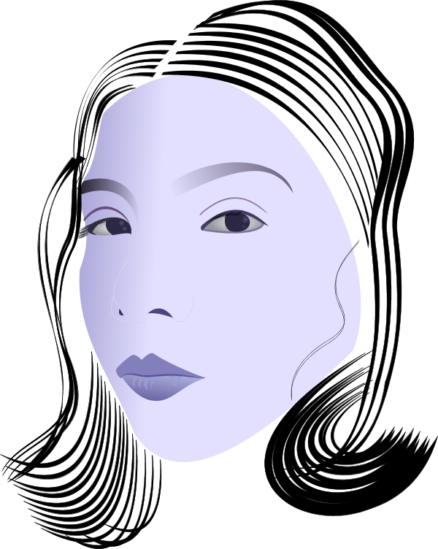
Division always makes things smaller. If I divide up a rich, tasty chocolate cake, I always get a smaller piece than the whole cake.
12 ÷ 4=3
3 is less than 12
Is she correct?

Slide 22

If you divide a number by 1,
it does not increase or decrease.
3 ÷ 1 = 3
If you divide 1, or a number larger than 1, by a proper fraction, the answer is greater than the original number.
4 ÷ $\frac{1}{2}$= 8 (8 > 4)

Slide 23
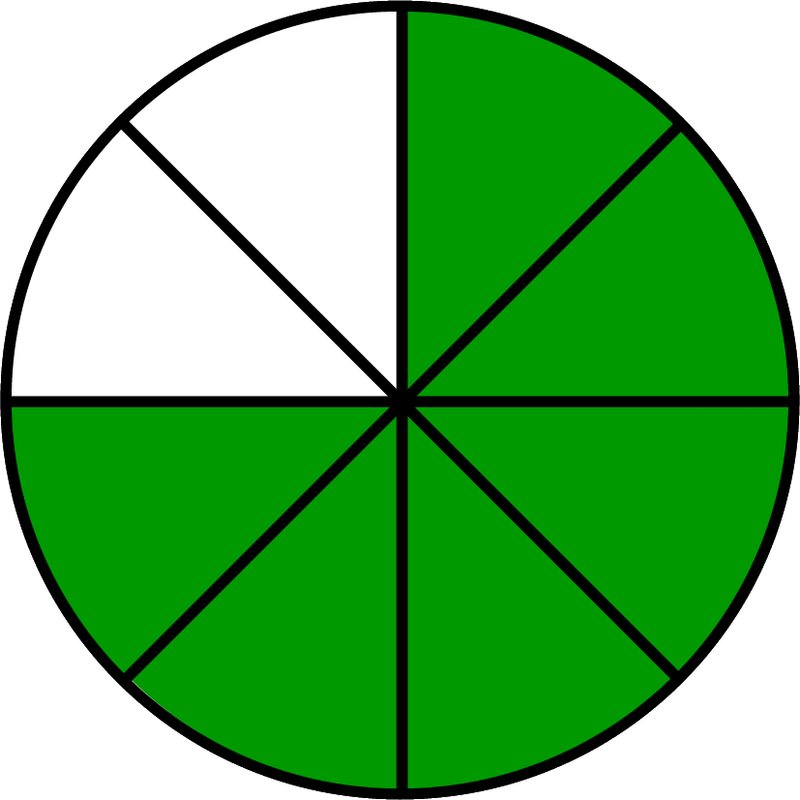
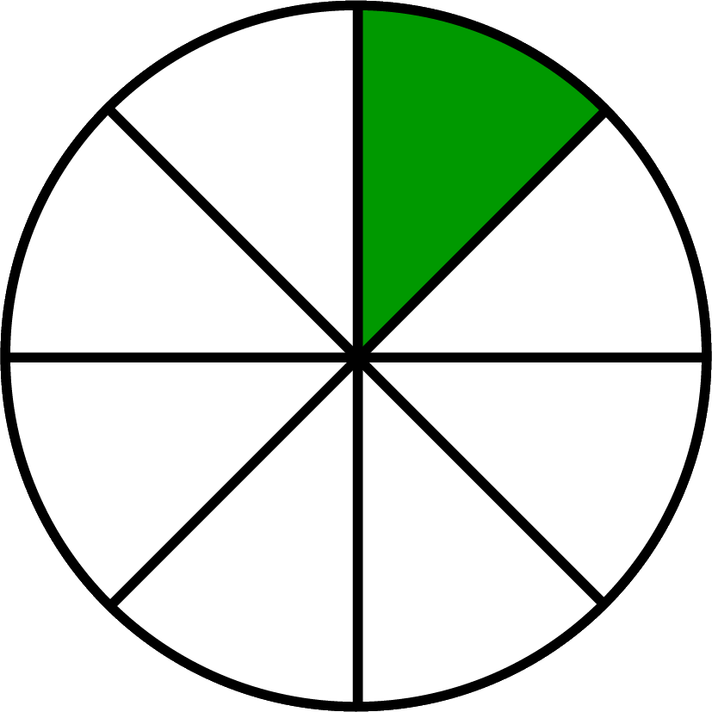


If you divide a larger fraction by a smaller
one, the answer will be more than 1.
$\frac{3}{4}$ ÷ $\frac{1}{8}$ = 6
÷ = 6
How many $\frac{1}{8}$ are there in $\frac{3}{4}$? 6

Slide 24
The end

