Slide 1


Multiplying Fractions
$$\frac{1}{2} of \frac{1}{3}= \frac{1}{6}$$
What is half of a third?
What does it mean?
Let’s show it diagrammatically.
The shaded blue part is half of a third, which is
$$\frac{1}{6}$$
$$\frac{1}{3}$$
Now, half this third…

Slide 2



Now try this yourself.
Remember to draw the diagram.
This is half of two thirds, which is
$\frac{2}{6}$
What is half of two thirds?
$\frac{1}{2} of \frac{2}{3}=\frac{2}{6}$
$$\frac{2}{3}$$
Now, half this two thirds…

Slide 3
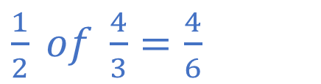

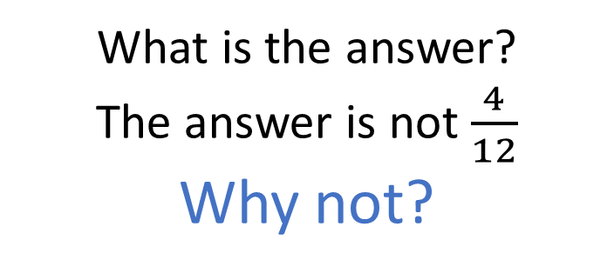
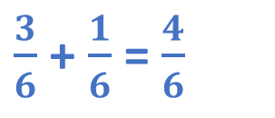
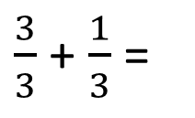
Try this one.
Remember to draw the diagram.
The blue shaded part is half of four thirds.
What is half of four thirds?
$\frac{1}{2} of \frac{4}{3}=\frac{4}{6}$
$\frac{3}{6}$ + $\frac{1}{6}$ = $\frac{4}{6}$
Now, half this four thirds…
$\frac{3}{3}$ + $\frac{1}{3}$ =
$$\frac{4}{3}$$
What is the answer?
The answer is not $\frac{4}{12}$
Why not?

Slide 4
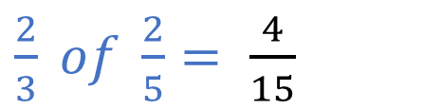

Here’s another to try:
What is two thirds of two fifths? Show it diagrammatically.
$\frac{2}{3} of \frac{2}{5}= \frac{4}{15}$
The blue shaded part is two thirds of two fifths.
That is
4 out of 15
parts.
$$\frac{2}{5}$$
Now, split each part into thirds then shade in two thirds of those parts…

Slide 5
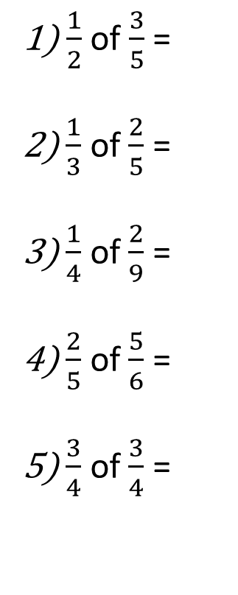
Independent activity:
Use diagrams to answer these:
1) $\frac{1}{2}$ of $\frac{3}{5}$ =
2) $\frac{1}{3}$ of $\frac{2}{5}$ =
3) $\frac{1}{4}$ of $\frac{2}{9}$ =
4) $\frac{2}{5}$ of $\frac{5}{6}$ =
5) $\frac{3}{4}$ of $\frac{3}{4}$ =

Slide 6
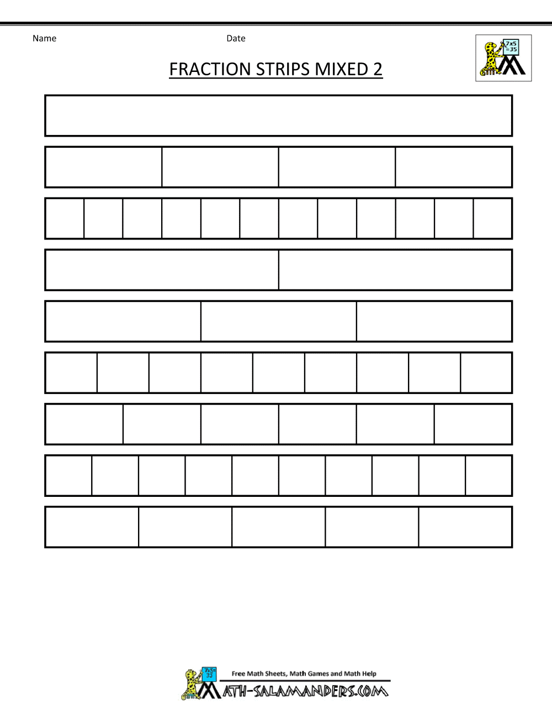
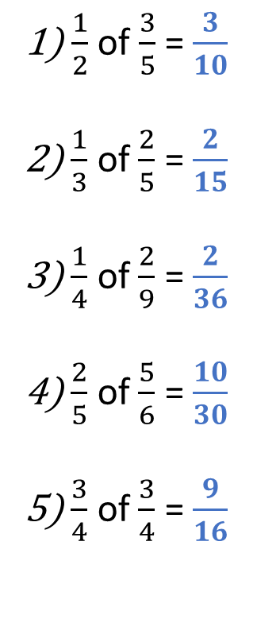
Solutions
1) $\frac{1}{2}$ of $\frac{3}{5}$ = $\frac{3}{10}$
2) $\frac{1}{3}$ of $\frac{2}{5}$ = $\frac{2}{15}$
3) $\frac{1}{4}$ of $\frac{2}{9}$ = $\frac{2}{36}$
4) $\frac{2}{5}$ of $\frac{5}{6}$ = $\frac{10}{30}$
5) $\frac{3}{4}$ of $\frac{3}{4}$ = $\frac{9}{16}$

Slide 7
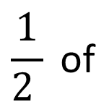
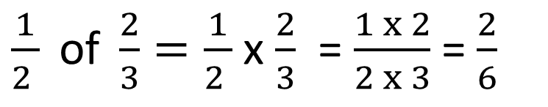
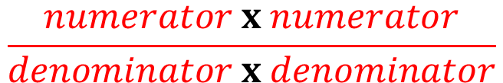


Using the example: What is half of two thirds?
What is the rule for multiplying fractions?
$$\frac{1}{2 } \text{of}$$
$$\frac{numerator}{denominator}$$
$$\frac{numerator}{denominator}$$
=
$$\frac{numerator x numerator}{denominator x denominator}$$
X
numerator
$\frac{1}{2 } \text{of} \frac{2}{3}=\frac{1}{2 }$ x $\frac{2}{3}$ = $\frac{1 x 2}{2 x 3}$ = $\frac{2}{6}$
of means multiply
denominator

Slide 8




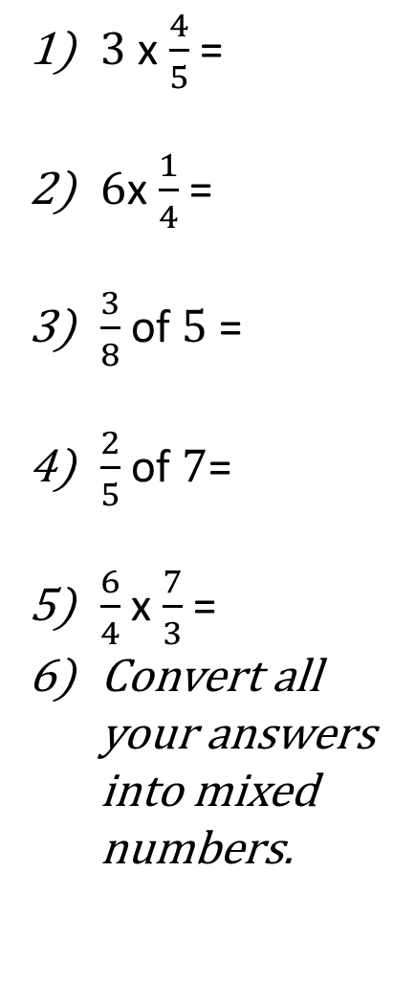
Try these questions. (Answer using diagrams/written method)
Challenge 5:
True or False
Show your working to explain your choice for each answer.
Challenge 1:
Challenge 2:
Challenge 3:
Challenge 4:
$\frac{1}{2}$ x $\frac{3}{7}$ =
$\frac{1}{3}$ of $\frac{2}{5}$ =
$\frac{1}{4}$ x $\frac{2}{9}$ =
$\frac{1}{5}$ of $\frac{6}{7}$ =
$\frac{1}{10}$ x $\frac{3}{4}$ =
$\frac{2}{3}$ x $\frac{2}{5}$ =
$\frac{4}{7}$ of $\frac{1}{6}$ =
$\frac{3}{4}$ x $\frac{3}{8}$ =
$\frac{4}{5}$ of $\frac{6}{10}$ =
$\frac{9}{11}$ x $\frac{7}{9}$ =
Simplify your answers to questions 2, 4 and 5
$3$ x $\frac{4}{5}$ =
$6$x $\frac{1}{4}$ =
$\frac{3}{8}$ of $5$ =
$\frac{2}{5}$ of $7$=
$\frac{6}{4}$ x $\frac{7}{3}$ =
Convert all your answers into mixed numbers.
$\frac{1}{6}$ x $4\frac{3}{5}$ =
$3\frac{1}{3}$ of $\frac{2}{6}$ =
$2\frac{5}{8}$ x $5$ =
$1\frac{2}{5}$ o$f 3\frac{1}{4}$=
$2\frac{3}{10}$ x $2$ $\frac{2}{9}$ =
Simplify and convert all your answers into mixed numbers.
$\frac{1}{3}$ of $\frac{2}{6}$ = $\frac{2}{9}$
$\frac{5}{8}$ x $\frac{2}{5}$= $\frac{1}{4}$
$\frac{1}{6}$ of $\frac{3}{5}$ = $\frac{1}{6}$
$2\frac{2}{3}$ x$1\frac{1}{2}$= 3
$1\frac{3}{5}$ of $2$ $\frac{2}{6}$ = 3 $\frac{11}{15}$

Slide 9
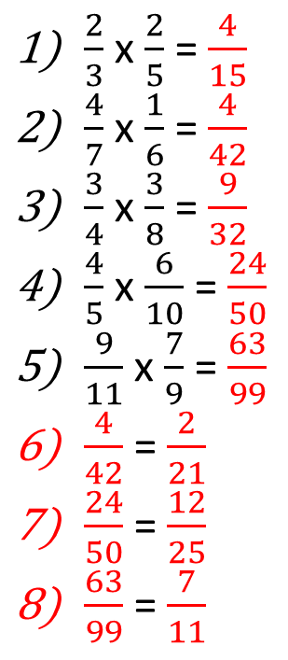
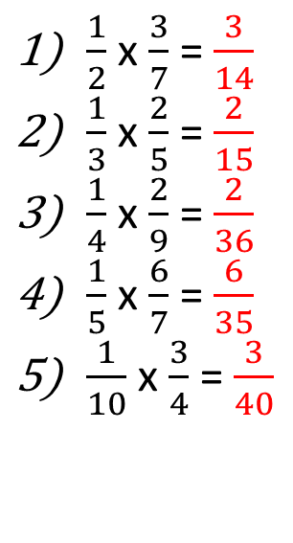
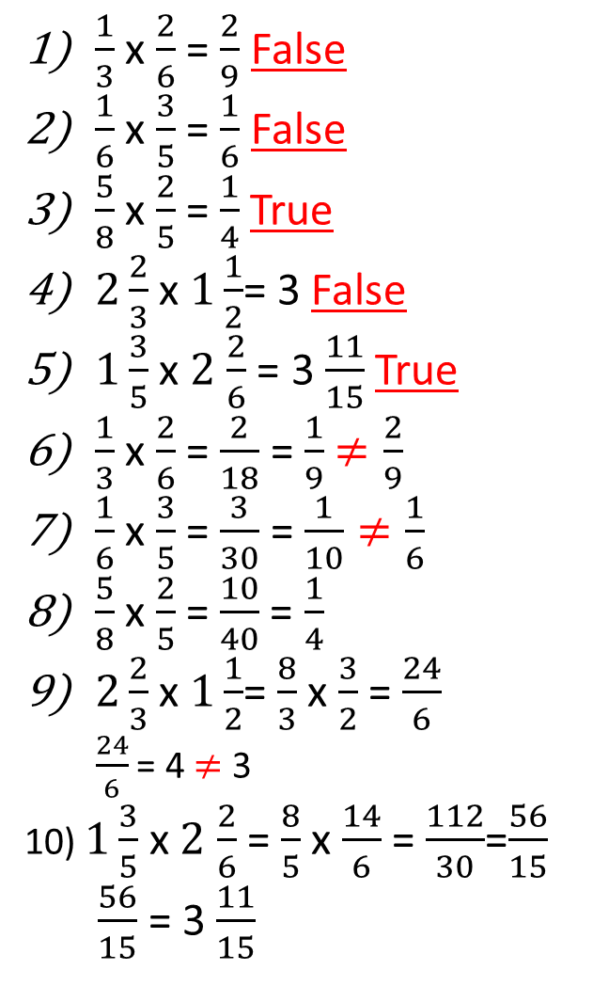
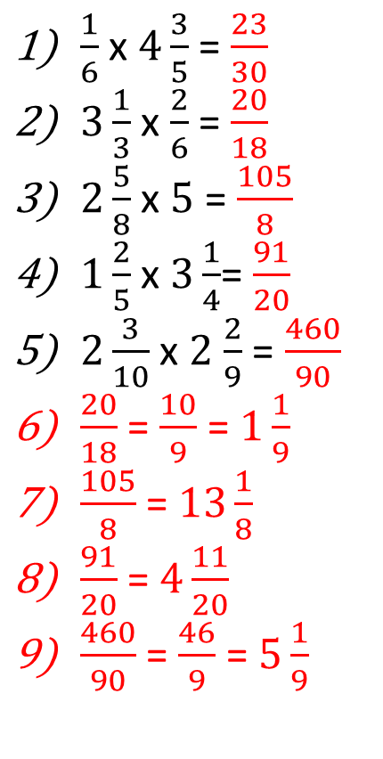
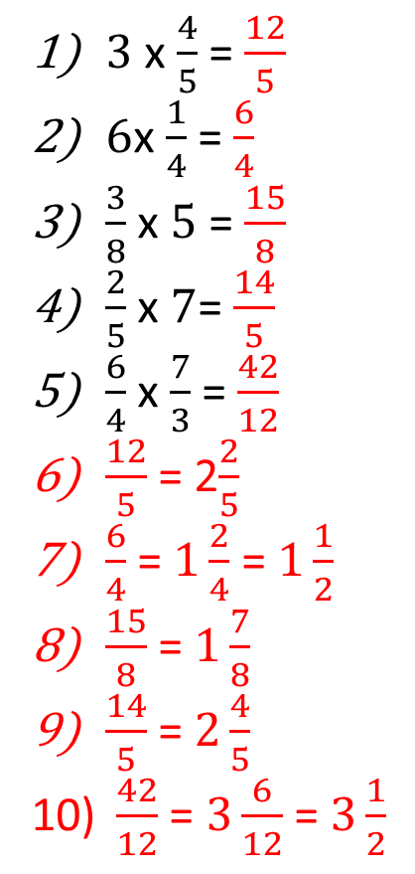
Challenge 5:
Solutions
$\frac{1}{3}$ x $\frac{2}{6}$ = $\frac{2}{9}$ False
$\frac{1}{6}$ x $\frac{3}{5}$ = $\frac{1}{6}$ False
$\frac{5}{8}$ x $\frac{2}{5}$= $\frac{1}{4}$ True
$2\frac{2}{3}$ x$1\frac{1}{2}$= 3 False
$1\frac{3}{5}$ x $2$ $\frac{2}{6}$ = 3 $\frac{11}{15}$ True
$\frac{1}{3}$ x $\frac{2}{6}$ = $\frac{2}{18}$ = $\frac{1}{9}$ $≠\frac{2}{9}$
$\frac{1}{6}$ x $\frac{3}{5}$ = $\frac{3}{30}$ = $\frac{1}{10}≠\frac{1}{6}$
$\frac{5}{8}$ x $\frac{2}{5}$= $\frac{10}{40}$ = $\frac{1}{4}$
$2\frac{2}{3}$ x$1\frac{1}{2}$= $\frac{8}{3}$ x $\frac{3}{2}$ = $\frac{24}{6}$
$\frac{24}{6}$ = 4 $≠$ 3
10) $1\frac{3}{5}$ x $2$ $\frac{2}{6}$ = $\frac{8}{5}$ x $\frac{14}{6}$ = $\frac{112}{30}$=$\frac{56}{15}$
$\frac{56}{15}$ = 3 $\frac{11}{15}$
Challenge 1:
Challenge 2:
Challenge 3:
Challenge 4:
$\frac{1}{2}$ x $\frac{3}{7}$ = $\frac{3}{14}$
$\frac{1}{3}$ x $\frac{2}{5}$ = $\frac{2}{15}$
$\frac{1}{4}$ x $\frac{2}{9}$ = $\frac{2}{36}$
$\frac{1}{5}$ x $\frac{6}{7}$ = $\frac{6}{35}$
$\frac{1}{10}$ x $\frac{3}{4}$ = $\frac{3}{40}$
$\frac{2}{3}$ x $\frac{2}{5}$ = $\frac{4}{15}$
$\frac{4}{7}$ x $\frac{1}{6}$ = $\frac{4}{42}$
$\frac{3}{4}$ x $\frac{3}{8}$ = $\frac{9}{32}$
$\frac{4}{5}$ x $\frac{6}{10}$ = $\frac{24}{50}$
$\frac{9}{11}$ x $\frac{7}{9}$ = $\frac{63}{99}$
$\frac{4}{42}$ = $\frac{2}{21}$
$\frac{24}{50}$ = $\frac{12}{25}$
$\frac{63}{99}$ = $\frac{7}{11}$
$3$ x $\frac{4}{5}$ = $\frac{12}{5}$
$6$x $\frac{1}{4}$ = $\frac{6}{4}$
$\frac{3}{8}$ x $5$ = $\frac{15}{8}$
$\frac{2}{5}$ x $7$= $\frac{14}{5}$
$\frac{6}{4}$ x $\frac{7}{3}$ = $\frac{42}{12}$
$\frac{12}{5}$ = 2$\frac{2}{5}$
$\frac{6}{4}$ = $1\frac{2}{4}$ = $1\frac{1}{2}$
$\frac{15}{8}$ = $1\frac{7}{8}$
$\frac{14}{5}$ = $2\frac{4}{5}$
$\frac{42}{12}$ = $3\frac{6}{12}$ = $3\frac{1}{2}$
$\frac{1}{6}$ x $4\frac{3}{5}$ = $\frac{23}{30}$
$3\frac{1}{3}$ x $\frac{2}{6}$ = $\frac{20}{18}$
$2\frac{5}{8}$ x $5$ = $\frac{105}{8}$
$1\frac{2}{5}$ x$3\frac{1}{4}$= $\frac{91}{20}$
$2\frac{3}{10}$ x $2$ $\frac{2}{9}$ = $\frac{460}{90}$
$\frac{20}{18}$ = $\frac{10}{9}$ = $1\frac{1}{9}$
$\frac{105}{8}$ = $13\frac{1}{8}$
$\frac{91}{20}$ = $4\frac{11}{20}$
$\frac{460}{90}$ = $\frac{46}{9}$ = $5\frac{1}{9}$

Slide 10

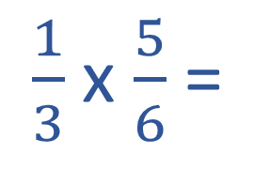
Plenary
The answer is this diagram:
$$\frac{5}{18}$$
What is the question? Can you work it out?
$\frac{1}{3}$ x $\frac{5}{6}$ =

