Slide 1
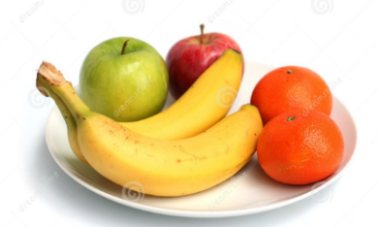
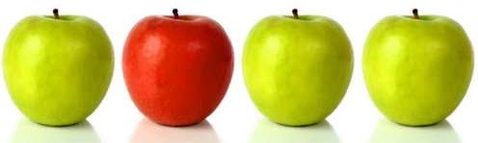
Mastery - fractions
Shaan, Zain, Anya and Simran share the fruit equally. There are 4 apples, 1 orange and 8 bananas. How many of each fruit do they receive? Fill the table.
 | apples | oranges | bananas
Shaan
Zain
Anya
Simran

Slide 2
Mastery - fractions
Saran, Mayar, Arjeevan and Krishav share the fruit equally. There are 8 apples, 2 oranges and 4 bananas. How many of each fruit do they receive? Fill the table.
 | apples | oranges | bananas
Saran
Mayar
Arjeevan
Krishav

Slide 3
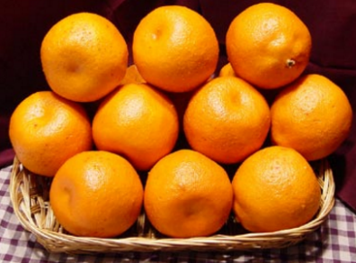
Mastery - fractions
Amber, Avleen, Jasmine and Yusuf share the fruit equally. There are 20 oranges, 1 apple and 12 bananas. How many of each fruit do they receive? Fill the table.
 | oranges | apples | bananas
Saran
Mayar
Arjeevan
Krishav

