Slide 1
Measurement
LI to read a gauge?

Slide 2
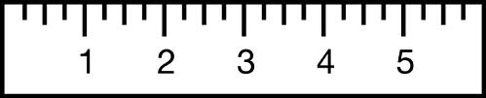
What does it read
Click on Answer to reveal
Answer
3

Slide 3
What does it read
Click on Answer to reveal
Answer
4

Slide 4
What does it read
Click on Answer to reveal
Answer
1

Slide 5

What does it read
Click on Answer to reveal
Answer
1.5

Slide 6

What does it read
Answer
5.5

Slide 7
What does it read
Answer
6

Slide 8
What does it read
Answer
2.5

Slide 9

What does it read
Answer
4

Slide 10
What does it read
Answer
1

Slide 11
What does it read
Answer
1.5

Slide 12
What does it read
Click on Answer to reveal
Answer
2.8

Slide 13
What does it read
Answer
6.2

Slide 14
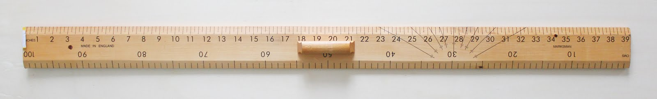
What does it read
Click on Answer to reveal
Answer
19 inches
19”

Slide 15
What does it read
Answer
35.5 inches
35.5”

Slide 16
What does it read
Answer
90cm

Slide 17
What does it read
Answer
35cm

Slide 18
What does it read
Answer
18cm

Slide 19
What does it read
Answer
72cm

Slide 20
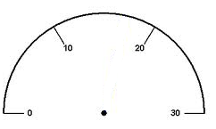
What does it read
Click on Answer to reveal
Answer
20

Slide 21
What does it read
Answer
10

Slide 22
What does it read
Answer
15

Slide 23
What does it read
Answer
25

Slide 24
What does it read
Answer
18

Slide 25
What does it read
Answer
21

Slide 26
What does it read
Answer
8

Slide 27
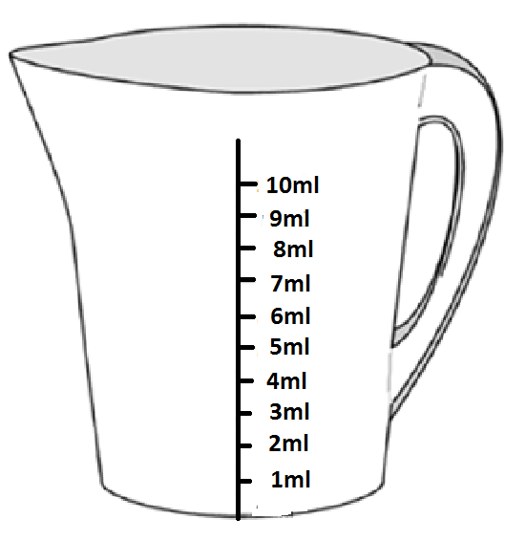
What does it read
Click on Answer to reveal
Answer
6ml

Slide 28
What does it read
Answer
2ml

Slide 29
What does it read
Answer
11ml

Slide 30
What does it read
Answer
3.5ml (3½ml)

Slide 31
What does it read
Answer
8.5ml (8½ml)

Slide 32
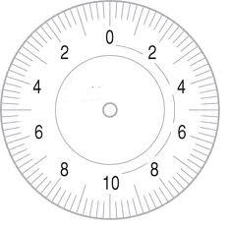
What does it read
Answer
2

Slide 33
What does it read
Click on Answer to reveal
Answer
4

Slide 34
What does it read
Answer
2

Slide 35
What does it read
Answer
7

Slide 36
What does it read
Answer
9.6

Slide 37

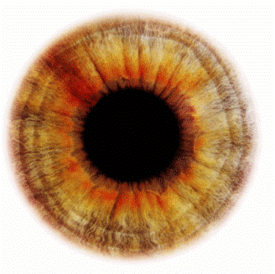

What does it read
Answer
7
Look carefully

