Slide 1

28/01/13
WALT: to use addition, subtraction, multiplication and division to solve a number investigation.
Hello Agents,
The mad scientist Dr Martin Bumbledorf is planning to take over the world.
I need you to find his secret plans to stop him!

Slide 2


I am Dr Martin Bumbledorf. I am going to rule the world!!!!!
I am planning to destroy everyone with my…………………………………………………………………………........LASER CATS!!!!!!!!!!

Slide 3
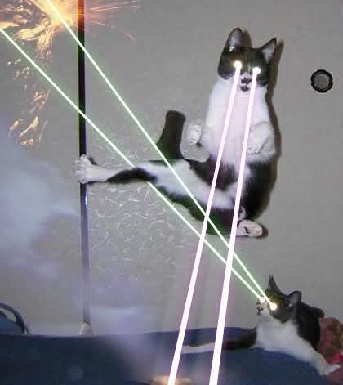


Slide 4
I have hidden my secret plans in my top secret, impossible to break, super strong safe. You will never stop me, mwah ha ha ha HA HA!!!!!!

Slide 5
To break the safe you will need to solve 5 problems to find the 5 numbers needed for the safe’s code.
Pick the correct numbers below to find the clues. Only 5 of these numbers hide clues.
35
The clues are hidden behind numbers that are:
-multiples of 7,
-odd numbers,
- <70
26
7
33
69
21
9
70
13
63
28
77
49
14
Enter Code

Slide 6
Clue 1
A class has 40 pupils. Today there are 4 children away.
The class teacher needs to split the remaining children into 6 equal groups for their maths lesson.
How many children will be in each group?
back

Slide 7
Clue 2
Sam, Ben, Katy and Pippa are eating some sweets.
There are 50 sweets altogether.
Sam eats 12 sweets.
Ben eats 9 sweets
Katy eats 21 sweets.
How many sweets are left for Pippa to eat?
back

Slide 8
Clue 3
Which one of these children is saying something wrong?
I have 85p pocket money.
I bought some sweets that cost 20p.
I think I have 55p left?
If I swam for 35 minutes and had a break. I then continued to swim for another 16 minutes. I must have swam for a total of 51 minutes
Tennis balls come in packs of 4. Mum bought me 9 packs.
I have 36 balls altogether.
1
2
3
back

Slide 9
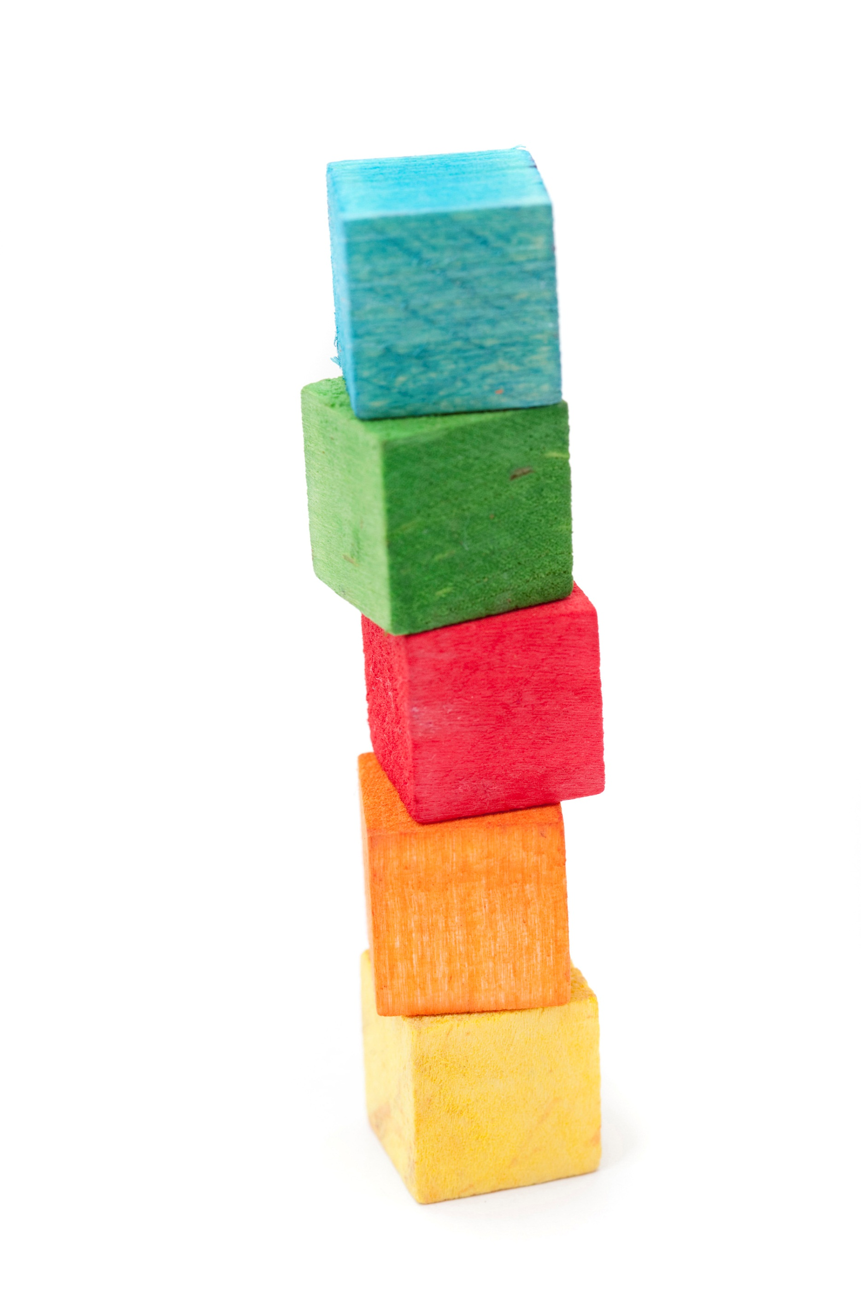
Clue 5
Jamie built a tower that was 72 cm tall.
He wants it to be 90cm tall.
Each brick is 9cm tall
How many more bricks does he need to finish his tower?
back

Slide 10

Quick agents, pick a correct number before the bomb explodes!!!!!
back

Slide 11
6
8
3
2
2
Open

Slide 12
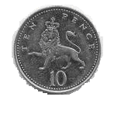
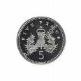
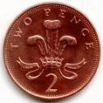

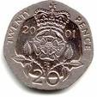
Clue 4
Crisps – 13p
Apples – 27p
Pizza - £1
Total = £1.40
1
Which shopping list can I buy with this amount of money?
Banana – 11p
Soup – 19p
Pasta – 20p
Total = 50p
2
Potatoes – 50p
Sweet – 2p
lolly – 1p
Total = 53p
3
Salad – 30p
Bread – 22p
Jelly– 10p
Total = 62p
back
4

Slide 13
Well done agents you have found the secret plans!!

