Slide 1
Shape –
Reasoning 2

Slide 2
Investigating Lines
Copy and complete the table:
 | True | Some-times | False
Parallel lines never touch
Perpendicular lines have to touch
When two lines cross they will make 4 right angles
A pair of parallel lines have to be the same length
Draw diagrams to prove what you have said.

Slide 3
Copy each shape carefully into your book.
Decide which one is the odd one out and explain why.
Copy each shape carefully into your book.
Decide which one is the odd one out and explain why.

Slide 4

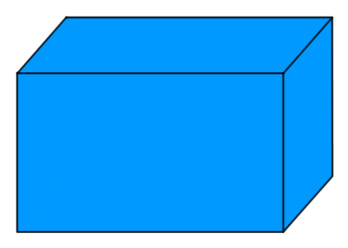

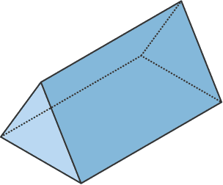
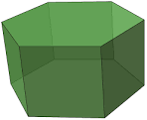


Copy each shape carefully into your book.
Decide which one is the odd one out and explain why.
Copy each shape carefully into your book.
Decide which one is the odd one out and explain why.

Slide 5


Copy each shape carefully into your book.
Decide which one is the odd one out and explain why.
Copy each shape carefully into your book.
Decide which one is the odd one out and explain why.

Slide 6
