Slide 1
Spatial Exploration with Pentominoes
By Mrs Philbin

Slide 2
What are pentominoes?
Pentominoes are shapes made by joining 5 squares together.
Squares must touch along their sides, not their corners, like these:

Slide 3
Challenge 1
There are 12 different pentominoes to find – you have already seen 2 of them.
Be careful though – rotations and reflections do not count.
For example:
These are all the same pentomino!

Slide 4
Challenge 1
Working on your own or with a partner see if you can make all 12 pentominoes.
Choosing a different colour for each pentomino will make it easier for you to spot the different combinations.

Slide 5
Challenge 1
You can either make your pentominoes out of cubes (3D pentominoes), or draw them on squared paper, colour them and then cut them out (2D pentominoes).
Ready?
Then off you go – you have 10 minutes!

Slide 6
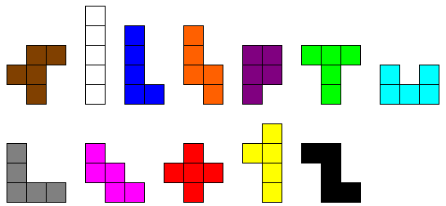
Challenge 1
Did you manage to find all 12?
You can check now. Here they are:

Slide 7
Challenge 2
Now that you have all 12 pentominoes (hopefully!), you are ready for the next challenge.
Using your 12 pentominoes, see if you can combine them to make a rectangle/cuboid.
It should be possible to make at least 4 different sizes of rectangles/cuboids.

Slide 8
Challenge 2
Remember:
There should not be any gaps in your shape.
There should not be any overlapping squares/cubes.
There should not be any squares/cubes sticking out from the shape.
You must use all 12 pentominoes.

Slide 9
Challenge 2
Ready?
Then off you go – you have 10 minutes!
Did you manage to make any rectangles?
There are thousands of possible solutions, but here are 4 to look at.

Slide 10
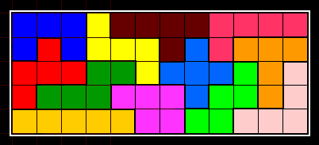
Challenge 2
One solution for a 5x12 rectangle
(5x12x1 cuboid)

Slide 11
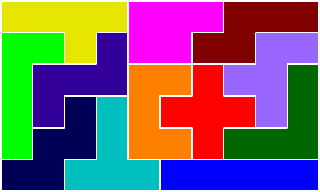
Challenge 2
One solution for a 6x10 rectangle
(6x10x1 cuboid)

Slide 12
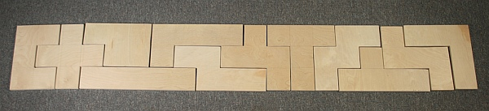
Challenge 2
One solution for a 3x20 rectangle
(3x20x1 cuboid)

Slide 13
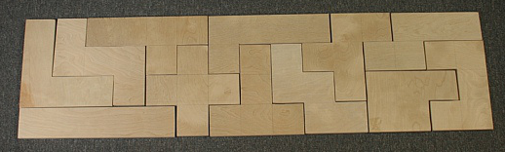
Challenge 2
One solution for a 4x15 rectangle
(4x15x1 cuboid)

Slide 14
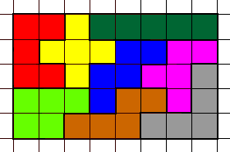
Challenge 3
Have a go at making rectangles or other shapes using just some of your pentominoes.
For example, this rectangle only uses 8 pentominoes.

Slide 15
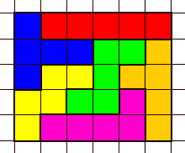
Challenge 3
And here is another rectangle that only uses 6 pentominoes.

