Slide 1
Money

Slide 2
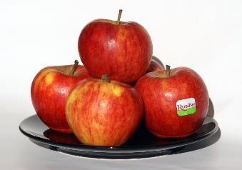
SPECIAL OFFER!
Tesco advertises fruit and vegetables on a special offer of “2 for €2”
Find out: How much are we saving?
Apples are normally €1.49 per bag.
How much do we save on this offer?

Slide 3
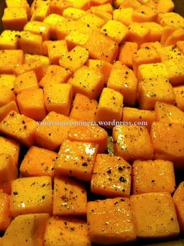
2 for €2
Butternut squash is usually €2.24, how much of a saving are we making by buying this on special offer?

Slide 4
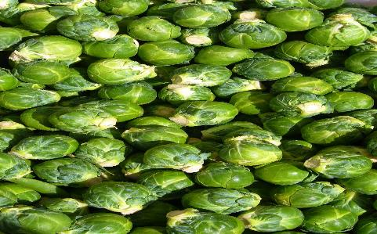
2 for €2
Brussel sprouts are normally €1.19, how much of a saving are we making during this special offer?

Slide 5

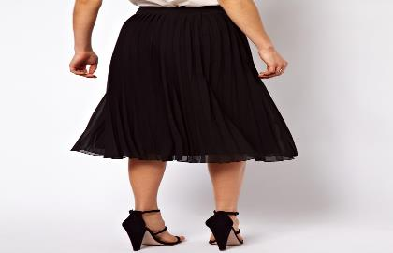
The same type of skirt is on sale for Black Friday in both River Island and New Look.
In River Island, the skirt is €67 with 30% off. In New Look, it is €40 with 15% off. Which is better value?

Slide 6
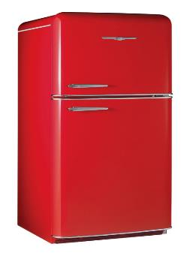

Mum bought a fridge the week before Black Friday. It cost €349. In the sales on Black Friday, it was advertised as having 20% off. How much extra did Mum pay?

Slide 7

Dave saved €150 on Black Friday when he bought his new Phillips SmartTV. The store he bought it in had a discount of 35% off. How much did his TV cost originally? How much did he pay for it?

