Slide 1




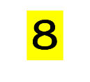
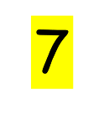

Slide 3
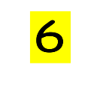





Slide 5

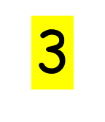





Slide 7


Slide 8
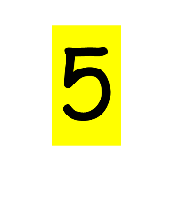


Slide 9


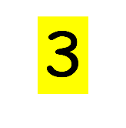

Slide 10

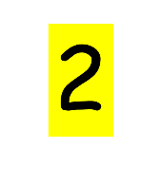


Slide 11

5
3
2
0

Slide 12
5
3
2
0

Slide 13
9
8
7
6
5
10

Slide 15



Slide 16


Slide 17







Slide 18
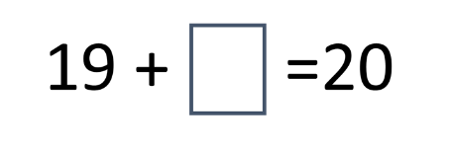

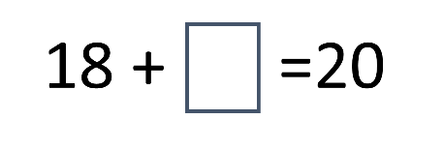

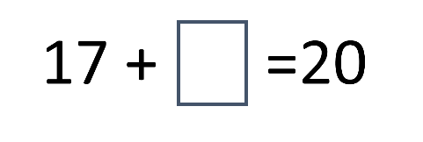


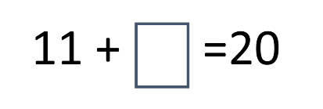



Slide 19











Slide 20




19 +
18 +

Slide 21

17 +
16 +

Slide 22

15 +
14 +

Slide 23


13 +
12 +

Slide 24
11 +
10 +

Slide 26


Slide 27
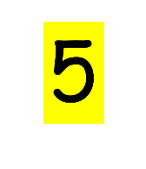



+

Slide 28

+

Slide 29

+

Slide 30
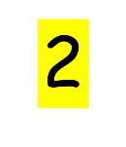
+

Slide 31

+

Slide 32

+

Slide 34


Slide 35


Slide 36


Slide 39






Slide 40
9 + =10

Slide 41
8 + =10

Slide 42
7 + =10

Slide 43
6 + =10

Slide 44
5 + =10

Slide 45
4 + =10

Slide 46
3 + =10

Slide 47
2 + =10

Slide 48
1 + =10

Slide 49
0 + =10

