Slide 1
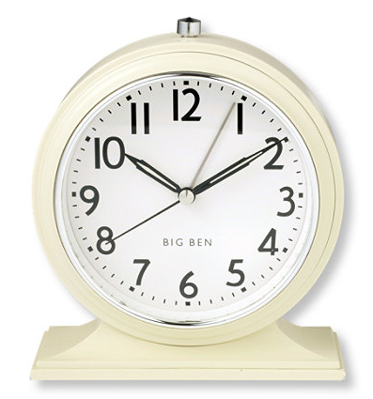

What time is it?
Tom Watt EAL Service Aberdeen Nov 2017

Slide 2
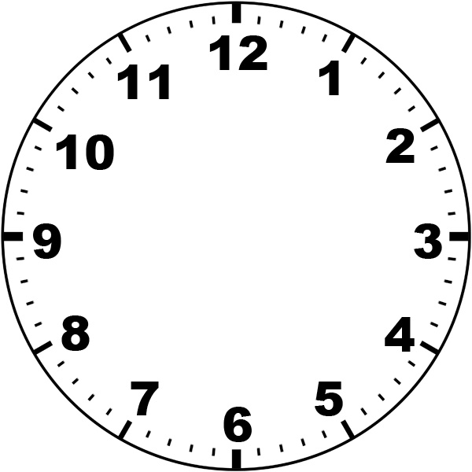

Slide 28

The End
HOURS and HALF HOURS
It is **** O’clock.
It is half past *** or
It is *** thirty.

