Slide 1
Writing times in digital

Slide 2
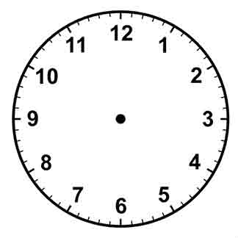
Analogue time
When we read the time off an analogue clock we read the minutes first, and then the hour.
The time given here is half past 7.
The time given here is twenty past 5
The exception is O’clock, where we write the hours first. E.g. 3 O’clock.

Slide 3
Digital time
To write twenty past 5 in digital time, we write the hours first.
We then write the minutes past the hour.
So, twenty past 5, is written as 5:20.
We write the hours, then a colon and then the minutes.

Slide 4
Digital time
We are familiar with counting minutes past the hour up to half past.
How do we write minutes to the hour in digital? E.g. twenty five to 4?
We continue to count how many minutes past the hour we have gone.
So, twenty five to 4, is 35 minutes past 4.
We write it in digital as 4:35.

Slide 5
Digital time
Have a go at writing these times on your whiteboards in digital time. Remember to put the hours first then the minutes.
Ten past 8
Twenty five to 3
5 past 10
Note that there must always be two digits for the minutes. So 5 past 10, is written 10:05, not 10:5

Slide 6
a.m. and p.m.
As the analogue clock face only shows 12 hours, and there are 24 hours in a day, we need to indicate if the time is before midday, or after midday.
If the time is before midday, we write a.m. after the time.
e.g. Twenty five past 11 in the morning is written as 11:25 a.m.
If the time is after midday, we write p.m. after the time. E.g. 10 past 2 in the afternoon is written as 2:10 p.m.

Slide 7
24 hour digital time
To avoid having to write a.m. or p.m, the 24 hour clock time, simply displays 4 digits which tell you if it is morning or afternoon.
Times before 1 p.m., are the same as the normal digital time.
e.g. Twenty five past 8 in the morning is written as 08:25
Note that we have two digits for the hours, so 8 a.m. is displayed as 08:00. Also the a.m. is removed.

Slide 8
24 hour digital times
Have a go at writing these times on your whiteboards in 24 hour digital time.
7:30 a.m.
9:20 a.m.
10: 35 a.m.

Slide 9
24 hour digital time
To display times from 1 p.m., we simply add 12 to the hours.
So, 1pm is displayed as 1 + 12 = 13:00
Note that we have removed the p.m.
Have a go at writing these times as 24 hour clock times.
3:17 p.m.
15:17
9:38 p.m.
21:38
7:09 p.m.
19:09
12:22 p.m.
12:22

