Slide 1

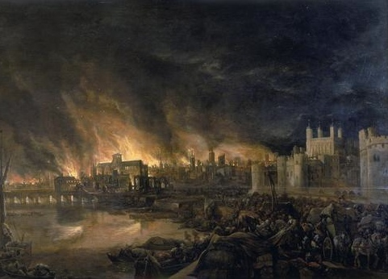
London’s Burning!
Year 2 History & Music

Slide 2

London’s burning, London’s burning,
Fetch the engines, Fetch the engines;
Fire, fire! Fire, fire!
Pour on water,
Pour on water.

Slide 3
Singing in a ‘round’ - 2 groups
London’s burning, London’s burning,
Fetch the engines, Fetch the engines;
Fire, fire! Fire, fire!
Pour on water,
Pour on water.
London’s burning, London’s burning,
Fetch the engines, Fetch the engines;
Fire, fire! Fire, fire!
Pour on water,
Pour on water.

Slide 4
Singing in a ‘round’ - 3 groups
London’s burning, London’s burning,
Fetch the engines, Fetch the engines;
Fire, fire! Fire, fire!
Pour on water,
Pour on water.
London’s burning, London’s burning,
Fetch the engines, Fetch the engines;
Fire, fire! Fire, fire!
Pour on water,
Pour on water.
London’s burning, London’s burning,
Fetch the engines, Fetch the engines;
Fire, fire! Fire, fire!
Pour on water,
Pour on water.

Slide 5
Singing in a ‘round’ - 4 groups
London’s burning, London’s burning,
Fetch the engines, Fetch the engines;
Fire, fire! Fire, fire!
Pour on water,
Pour on water.
London’s burning, London’s burning,
Fetch the engines, Fetch the engines;
Fire, fire! Fire, fire!
Pour on water,
Pour on water.
London’s burning, London’s burning,
Fetch the engines, Fetch the engines;
Fire, fire! Fire, fire!
Pour on water,
Pour on water.
London’s burning, London’s burning,
Fetch the engines, Fetch the engines;
Fire, fire! Fire, fire!
Pour on water,
Pour on water.

Slide 6
Which classroom instruments could we use to play along with the song?
London’s burning, London’s burning,
Fetch the engines, Fetch the engines;
Fire, fire! Fire, fire!
Pour on water, Pour on water.
Think
Pair
Share!

Slide 7
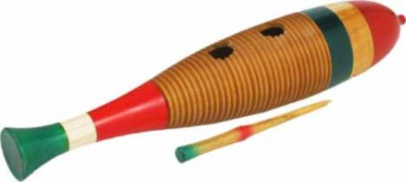
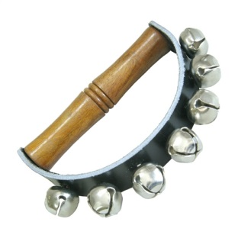
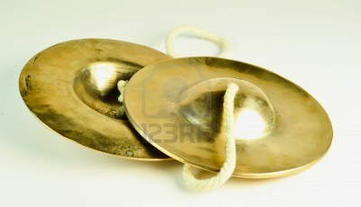
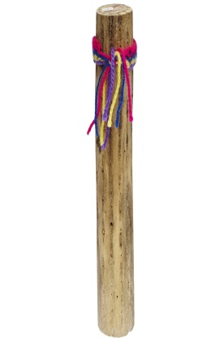
Let’s try the song with these instruments….
London’s burning, London’s burning,
Fetch the engines, Fetch the engines;
Fire, fire! Fire, fire!
Pour on water, Pour on water.

Slide 8
Which instruments work well? Why?
Which instruments could you change? Why?

