Slide 1
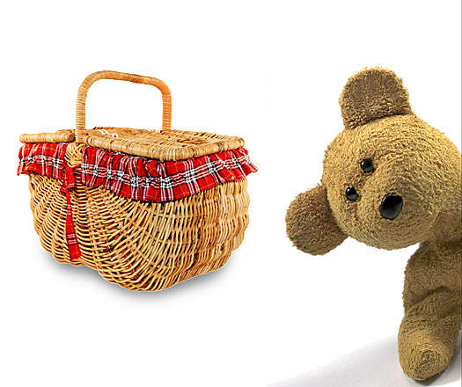

Teddy Bear Musical Picnic
Reception Class: Music
How LOUD?!

Slide 2
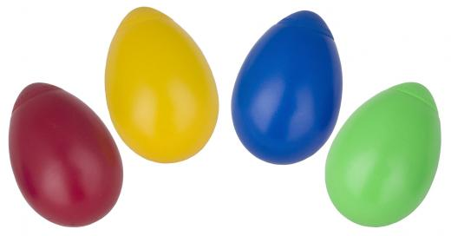

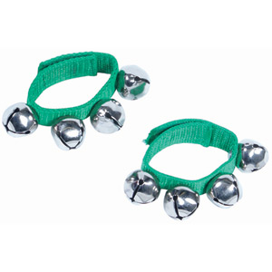
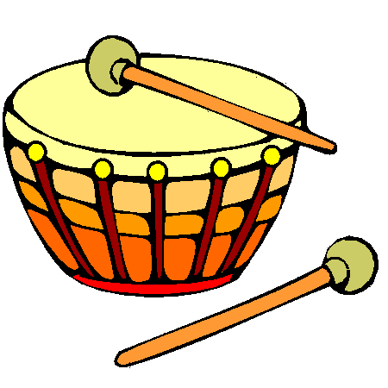
What’s in the picnic basket?

Slide 3


Loud
Quiet

Slide 4
Can you play this pattern?

Slide 5
Can you play this pattern?

Slide 6

Can you play this pattern?

Slide 7
Can you make a LOUD and quiet pattern with your partner?

Slide 8
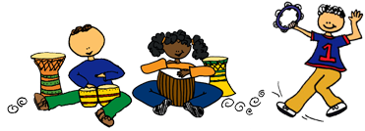
Can you perform your LOUD and quiet pattern?

Slide 9

How did you do?
I didn’t understand and I need help from an adult
I’m beginning to understand and could use a bit of practice with an adult
YES! I understand! I’m ready to practice by myself.

Slide 10

loud
loud
loud
loud
quiet
quiet
quiet
quiet

Slide 11
loud
loud
loud
loud
quiet
quiet
quiet
quiet

