Slide 1
How to resolve a conflict peacefully!

Slide 2
Sort things out so everyone gets something of what they want.
There are FOUR things you need to do.
      Understand
      Avoid making things worse
      Work together
      Find the solution

Slide 3
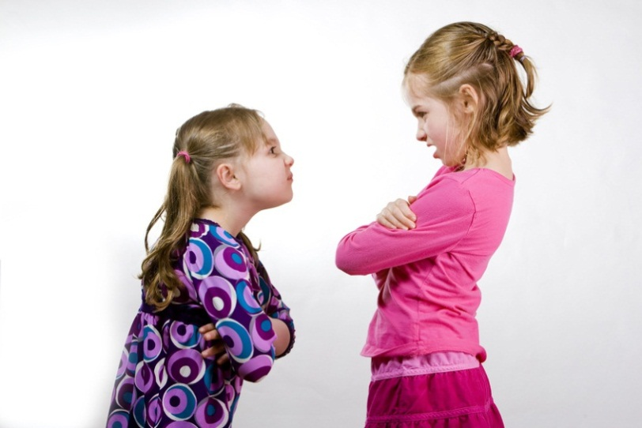
Understand
Everyone in the conflict must UNDERSTAND what the conflict is about!

Slide 4
Avoid making things worse
No mean, nasty comments.
No screaming or shouting.
No fighting or hurting the other person.

Slide 5


Work together
Say what you feel without blaming the other person. “I feel sad when you shout.”
Take turns speaking.
Talk quietly.
Show you are listening by looking at the other person.

Slide 6
Find the solution
Brainstorm together to think how to resolve the conflict.
It may help to ask another person for ideas too!

Slide 7


Possible outcomes
YES/YES
  When both of you are pleased with what you worked out.
YES/NO
  When one person is happy because they got what they wanted BUT one person is not happy because they have not got what they wanted.
NO/NO
  When no one is happy.

Slide 8

PLEASE REMEMBER:
Think about the problem.
Say what you feel.
Listen to the other person.
Brainstorm possible solutions.

Slide 9
PLEASE REMEMBER:
Decide what each of you will do.
Stick to what you have decided.
Talk again if the solution is not working.

Slide 10



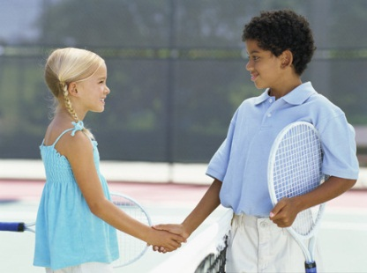
I’m feeling really angry,
I want to stamp and scream.
I never thought she’d break it,
Not in my wildest dream.
I don’t think that I’ll forgive her,
For ever and a day.
But, I’ll take a breath and listen,
To what she’s got to say.
I’m feeling quite ashamed now,
For shouting out like that.
My sister didn't break it.
The culprit was the cat.
We’ve come to a solution.
“We’ll lock our door,” we said.
We shook hands with each other.
The cat went to the shed.

