Slide 1
Sikhism
Founded in the Punjab, India in the 15th Century – about 500 years ago.
30 Million Sikhs
Sikh means: disciple/follower

Slide 2
Sikhs believe
There is only one God
God is without form, or gender
Everyone has direct access to God
Everyone is equal before God
A good life is lived as part of a community, by living honestly and caring for others
Empty religious rituals and superstitions have no value

Slide 3
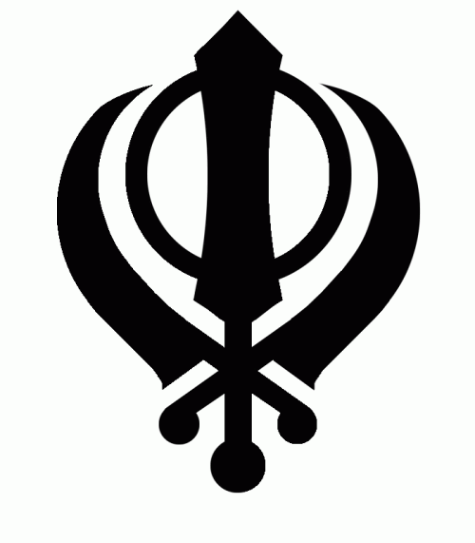
Sikhs symbol: The Khanda
Double edged Sword
Circle
Two swords
A circlet represents unity, a sense of being at one with infinity.
Two swords, signify the spiritual and secular forces influencing the soul.
A double edged sword symbolizes the ability of truth to cut through the duality of illusion.

Slide 4
Sikh Gurus
Guru means teacher.
First Guru was Guru Nanak.
There were 9 others.
There are no living Gurus now but the Sikhs call their Holy Scriptures, Gurū Granth Sāhib. This is their only Guru.

Slide 5
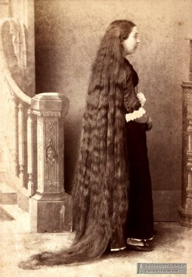
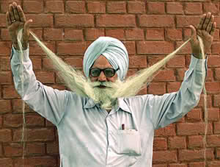
5 K’s of Sikhism
Kesh – not cutting hair.

Slide 6
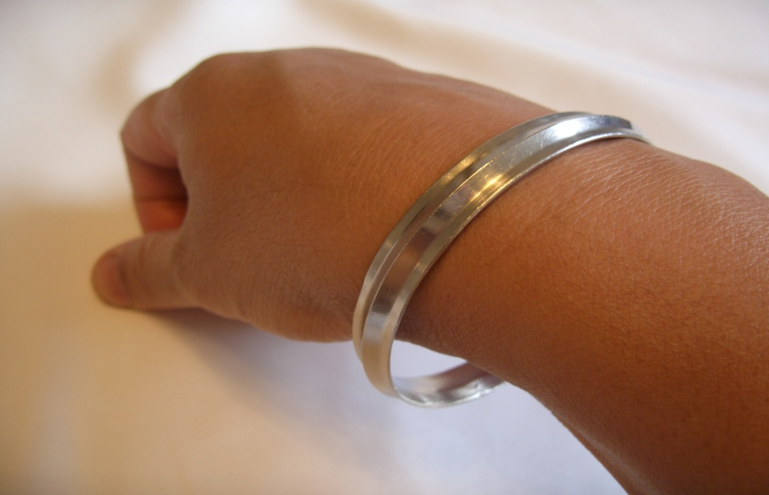
5 K’s of Sikhism
Kara – a steel bracelet

Slide 7
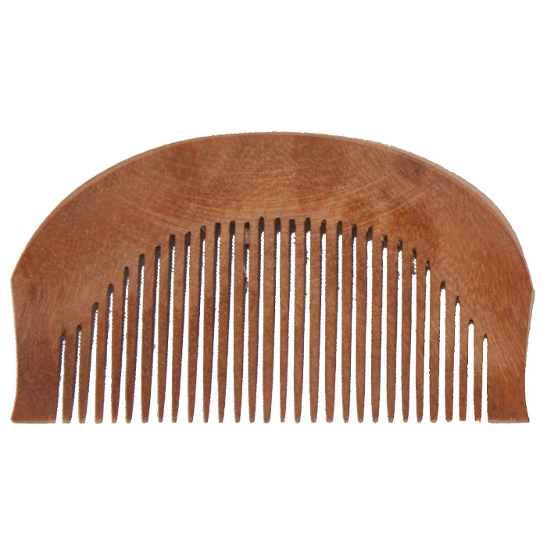
5 K’s of Sikhism
Kanga – a comb.

Slide 8
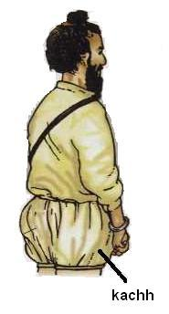
5 K’s of Sikhism
Kaccha – shorts

Slide 9
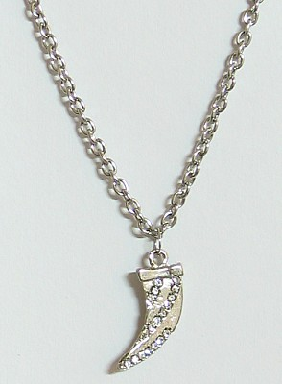
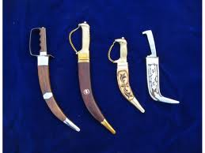
5 K’s of Sikhism
Kirpan – ceremonial dagger.

Slide 10
Sikhism
Pray
Work
Give

