Slide 1
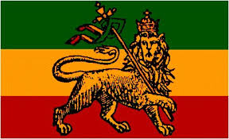
Rastafari

Slide 2
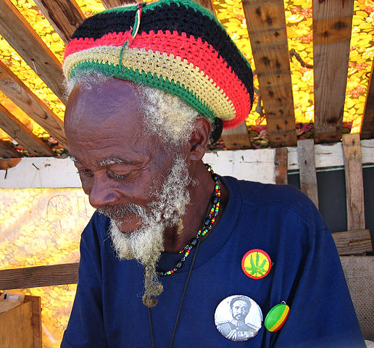
Someone who follows the Rastafari faith is called a Rastafarian or Rasta.
Rastas believe that God lives in man. They call God ‘Jah’.
They also believe that nature should be protected.

Slide 3
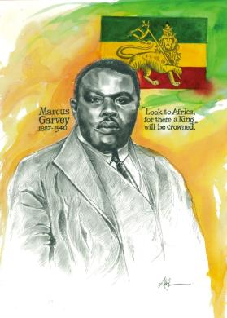
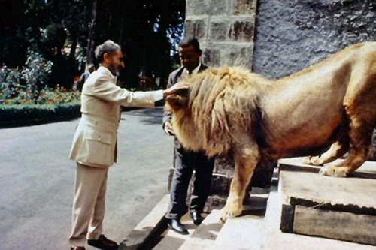
The Rastafari faith was developed in Jamaica in the 1930s by Marcus Garvey. He wanted to improve the status of black people. Most Rastafarians live in Jamaica.
Rastafarians see Haile Selasse as a god. He was king of Ethiopia, a country in
Africa.

Slide 4
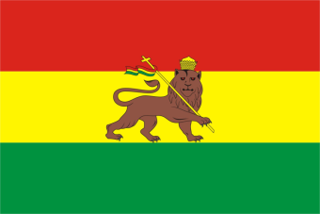
Red represents the blood and suffering of black people.
The 3 main Rasta colours are red, yellow and green. They each symbolize something in Rastafarianism. They are also the colours of the Ethiopian flag.
Yellow (gold) represents the wealth and prosperity Africa and Ethiopia have to offer.
Green represents the beauty and vegetation of Africa and Ethiopia.

Slide 5
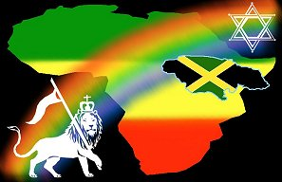
Symbol
The lion is the symbol of the Rastafari faith. Haile Selasse is believed to be the lion mentioned in the bible.

Slide 6
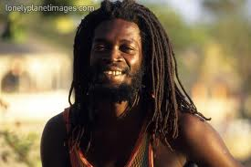
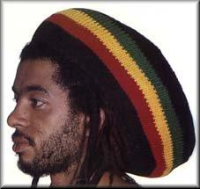
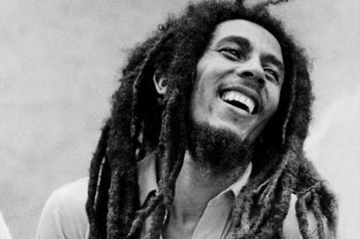
Dreadlocks
Rastas believe that it says in the bible people must not cut their hair, so they grow and twist it into dreadlocks.
The dreadlocks are thought to represent the lion’s mane too.

Slide 7
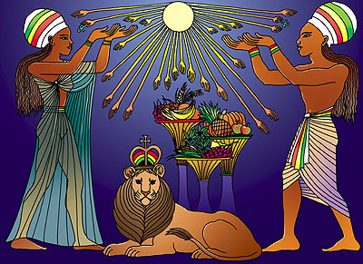
Diet
Rastafarians eat clean and natural produce, such as fruit and vegetables.
Rastafarians try to not eat meat, especially pork, or drink alcohol.
Many Rastafarians are vegans.

Slide 8
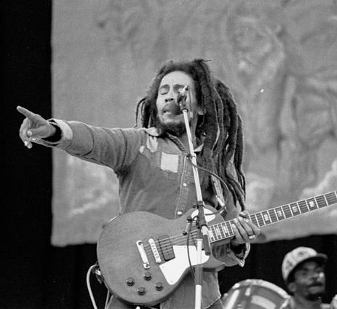
Bob Marley
Bob Marley was a famous reggae music artist who was appreciated in Rasta culture for telling about Rastafarian beliefs in his music.
http://www.youtube.com/watch?v=1zNyAcE55Ws

Slide 9
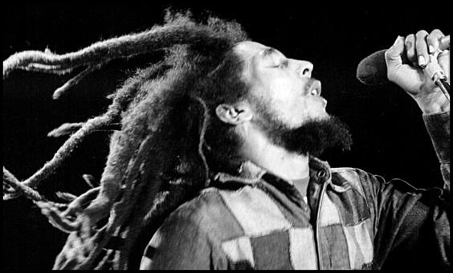
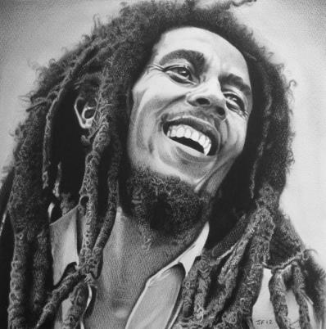
…
Bob Marley’s music helped to make Rastafari more popular around the world.
.
There are now approximately 1 million followers of this faith with 5,000 Rastafarians in England and Wales.
http://www.youtube.com/watch?v=tbqyq-cWQBQ

Slide 10
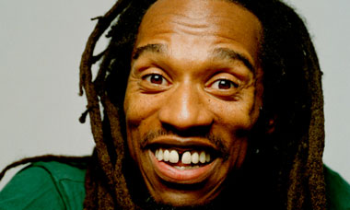
Benjamin Zephaniah
http://www.youtube.com/watch?v=82_so2mIe5c
http://www.youtube.com/watch?v=VslQ_36Tn0k

