Slide 1
Learning Objective
To know what contributes towards being an effective team member.
Success Criteria
All- I can identify some improvements that I need to make in order to work more effectively in my team.
Most- I can identify some improvements that myself and my team mates could make in order to work more effectively in my team.
Some- I can achieve the above criteria and make these improvements during today’s tasks.

Slide 2
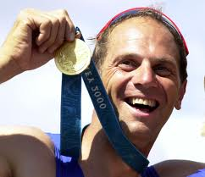
Sir Steve Redgrave
‘It's not always a bed of roses, but the blend of
characters makes
the strength of
the team’

Slide 3

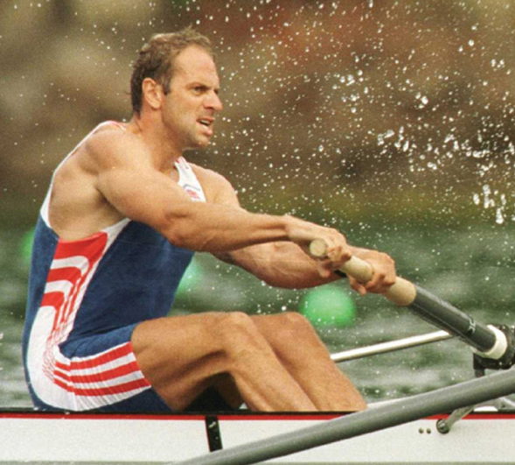
Sir Steve Redgrave
Physical: Very tall and therefore applies longer strokes.
Mental: An amazing self-motivator.
Academic: Practical subjects such as P.E, Art and music.
Personality: Steve is a natural leader and organised most of the meetings. However, he was bale to use a balance of his team mates ideas and opinions and therefore showed great respect.
Learning style: Pragmatist (keen to take on board new ideas and is excited about testing them)
Bonus skill: Steve found hand writing and spelling challenging at school and dedicated much of his time to overcome this.

Slide 4
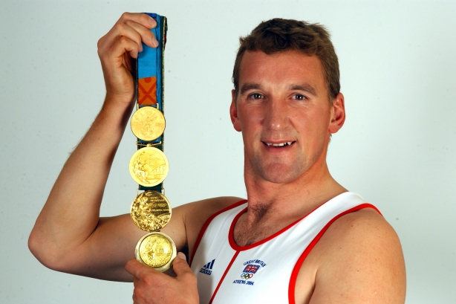
Matthew Pinsent
Physical: He had at one time the largest lung capacity recorded for a sportsman at 8.5 litres.
Mental: Never gives up (perseverance).
Academic: Oxford with a degree in Geography.
Personality: Calm and considered
Learning style: Theorist (thinks problems through step- by-step)
Bonus skill: Listens carefully to other people’s opinions and takes time to reflect before expressing his thoughts.

Slide 5

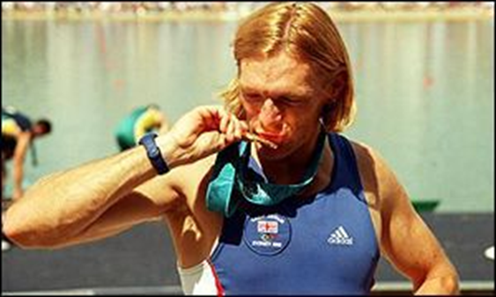
Tim Foster
Physical: Very fast oarsman.
Mental: Showed great determination to come back from injuries.
Academic: Economics (good with money)
Personality: Adds humour when appropriate (team spirit)
Learning style: Activist (tends to act first and consider the implications afterwards).
Bonus skill: Always encouraging other team mates.

Slide 6
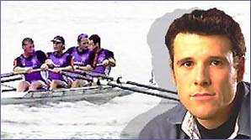
James Cracknell
Physical: Very fast oarsman.
Mental: Very competitive.
Academic: Science degree
Personality: Loves the outdoors and always tells friends interesting facts about nature.
Learning style: Reflector (listens carefully to others and thinks things through before making suggestions)
Bonus skill: As a qualified scientist, James is always suggesting ways for himself and his team to improve.

Slide 7
Physical:
Mental:
Academic:
Personality:
Learning style:
Theorist (thinks problems through step- by-step)
Activist (tends to act first and consider the implications afterwards).
Pragmatist (keen to take on board new ideas and is excited about testing them)
Reflector (listens carefully to others and thinks things through before making suggestions)
Bonus skill:
‘

Slide 8



